Slide 1
AWS Foundations
AWS Cloud Essentials

Slide 2
Agenda
Slide 4: Compute Resources
Slide 44: Storage
Slide 55: break for 10 min
Slide 56: Databases
Slide 91: Networking
Slide 111: Submission for AWS labs
End with review of Weeks 1 & 2 from Tyler’s videos

Slide 3
AWS Compute services
EC2
Elastic Beanstalk
EC2 Auto Scaling
Lambda
Elastic Container Service (ECS)
Elastic Kubernetes Service (EKS)
EC2 Container Registry
Fargate

Slide 4
Compute services
EC2 (Elastic Compute Cloud)
Provides resizable compute capacity in the cloud, reducing the time required to obtain and boot new server instances.
Offers a wide variety of instance types optimized to fit different use cases, such as memory-optimized, compute-optimized, and storage-optimized instances.
Supports a broad range of operating systems and software packages, and offers flexible options for memory, CPU, and instance storage.

Slide 5
Instance type: General Purpose
Instance Type: t3, m5
Use Case: Applications with balanced compute, memory, and networking needs. Examples include web servers, micro-services, and small to medium-sized databases.

Slide 6
Instance type: General Purpose
Burstable Instances
What it is: Burstable instances are designed to provide a baseline level of CPU performance with the ability to burst above that baseline when needed. They are ideal for workloads that do not use the full CPU often, but occasionally need to burst to higher CPU performance.
Use Cases: Small and medium databases, low to moderate traffic web servers, development environments, code repositories, microservices.

Slide 7
Instance type: Compute Optimized
Instance Type: c5
Use Case: Applications that need high performance processors. Examples include high-performance web servers, scientific modeling, batch processing, and multiplayer gaming.

Slide 8
Instance type: Compute Optimized
Non-Burstable Instances
What it is: Non-burstable instances provide a consistent CPU performance regardless of the workload. They do not offer the ability to burst to higher levels. They are ideal for applications that need a steady state of high CPU performance.
Use Cases: High-traffic web servers, CPU-intensive applications, gaming servers, ad serving, scientific modeling, batch processing.

Slide 9
Burstable vs Non-Burstable Instances
1) Performance Flexibility: Burstable instances provide flexible CPU performance, allowing to burst when required, while non-burstable instances deliver a steady, high CPU performance.
2) Cost Efficiency: Burstable instances can be more cost-effective for workloads with variable CPU usage.
3) Consistent Performance: Non-burstable instances are ideal for applications that require consistent, high CPU performance.

Slide 10
Instance type: Memory Optimized
Instance Type: r5, x1, u-6tb1
Use Case: Applications that process large data sets in memory. Examples include high-performance databases, data mining & analysis, in-memory databases, and real-time big data analytics.

Slide 11
Instance type: Accelerated Computing
Instance Type: p3, g4, f1
Use Case: Applications that benefit from hardware accelerators, or co-processors. Examples include machine learning, high-performance computing, video processing, and computational fluid dynamics.

Slide 12
Instance type: Storage Optimized
Instance Type: i3, d2, h1
Use Case: Applications that require high, sequential read and write access to large data sets on local storage. Examples include NoSQL databases, in-memory databases, scale-out transactional databases, data warehousing, and Elasticsearch.

Slide 13
Compute services
Elastic Beanstalk
An easy-to-use service for deploying and scaling web applications and services developed with Java, .NET, PHP, Node.js, Python, Ruby, Go, and Docker.
Handles capacity provisioning, load balancing, auto-scaling, and application health monitoring.
Allows developers to focus on writing code without worrying about the underlying infrastructure.

Slide 14
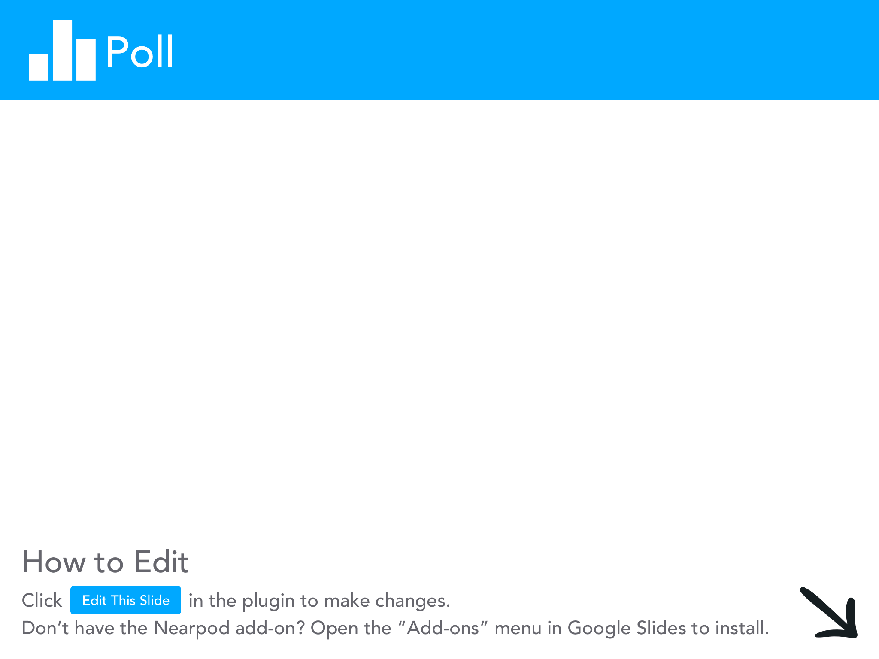
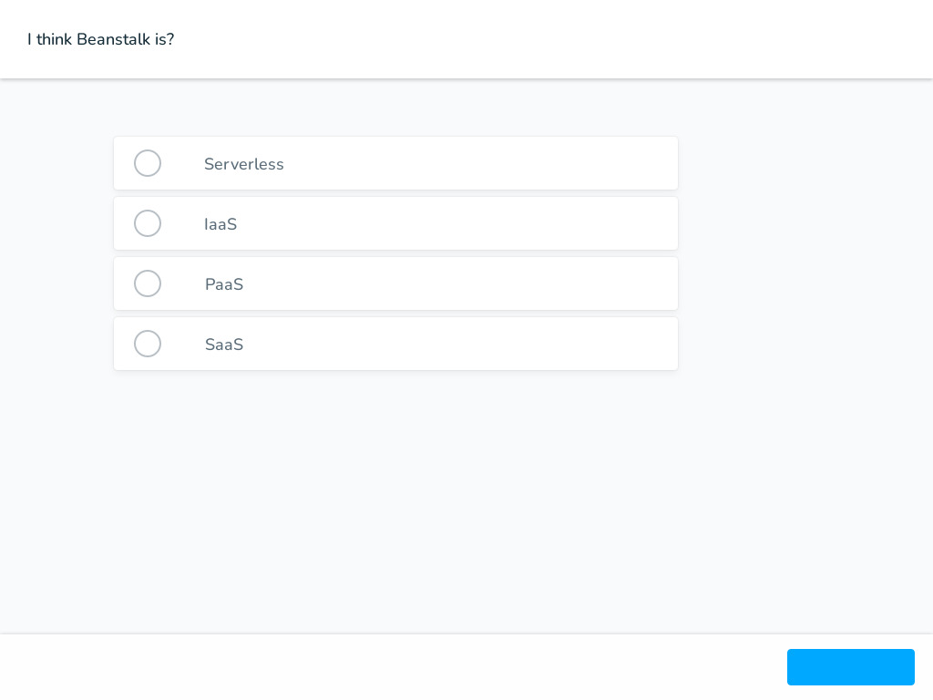

Slide 15
Compute services
Elastic Beanstalk
Beanstalk provides preconfigured runtime environments for common programming languages (like Java, .NET, PHP, Python, Ruby, Go, Node.js) and Docker.

Slide 16
Compute services
Elastic Beanstalk
SaaS? You’ve been Noped, you manage Security Groups, Storage, and heck you write the application.
Serverless? Noped again, this system is always running and not event driven.

Slide 17
Compute services
Elastic Beanstalk
Elastic Beanstalk is categorized as a PaaS offering. It provides a platform (runtime environment + infrastructure + additional services like load balancing, auto-scaling, database integration, etc.) for developers to run their applications

Slide 18
Compute services
EC2 Auto Scaling
Helps ensure that you have the correct number of Amazon EC2 instances available to handle the load for your application.
Scales up automatically to maintain performance during demand spikes and scales down during demand lulls to minimize costs.
Supports both dynamic and predictive scaling.

Slide 19
Compute services
EC2 Auto Scaling
Define Scaling Policies: You can define scaling policies based on specific conditions like CPU utilization, number of requests per second, or any custom metric that you choose. These policies will trigger the Auto Scaling process.
Automatic Scaling: When a defined condition is met, EC2 Auto Scaling automatically adds or removes EC2 instances from your Auto Scaling group. For example, if the CPU utilization of your EC2 instances goes above 70%, you can configure a policy to add more instances, spreading the load and reducing the overall CPU utilization. Conversely, if CPU utilization is too low, it can remove instances, saving you costs.
So, in essence, Scaling Policies are the "instructions" for dynamic scaling, and Automatic Scaling is the "action" of dynamic scaling.

Slide 20
Compute services
EC2 Auto Scaling
Load Balancing: EC2 Auto Scaling can work together with Amazon Elastic Load Balancer (ELB) to distribute incoming application traffic across multiple EC2 instances for efficient load handling. This increases the availability and fault tolerance of your applications.
Health Checks: EC2 Auto Scaling performs health checks on the instances within its Auto Scaling groups. If an instance becomes unhealthy, the service terminates it and launches a new one to replace it, ensuring your application remains available.

Slide 21
Compute services
EC2 Auto Scaling
Scheduled Scaling: Besides scaling in response to conditions, you can also schedule scaling actions ahead of time. For instance, if you predict higher load on your application every weekday between 9 AM to 5 PM, you can schedule your Auto Scaling group to have more instances during this period.

Slide 22
Compute services
EC2 Auto Scaling
In Microsoft Azure, the equivalent of AWS EC2 Auto Scaling is Azure Autoscale
The features are identical

Slide 23
Compute services
Lambda
Lets you run code without provisioning or managing servers, only paying for the compute time you consume.
Automatically scales your applications in response to incoming request traffic.
Can be set up to respond to changes in data in Amazon S3, Amazon DynamoDB tables, modifications to deployment pipelines, and custom events.

Slide 24


Slide 25
Compute services
Lambda
AWS Lambda and Azure Functions are both examples of Function as a Service (FaaS) offerings, which are key components in serverless computing. Recall, stateless vs stateful and event driven.

Slide 26
Compute services
Elastic Container Service (ECS)
A highly scalable, high-performance container orchestration service that supports Docker containers.
Allows you to easily run and scale containerized applications on AWS.
Integrates with AWS core services such as Amazon Route 53, Secrets Manager, and CloudWatch.

Slide 27
Compute services
Elastic Kubernetes Service (EKS)
Managed service that makes it easy to deploy, manage, and scale containerized applications using Kubernetes on AWS.
Seamlessly integrates with other AWS services for scalability and security.
Automatically manages the availability and scalability of the Kubernetes control plane nodes.

Slide 28
Compute services
EC2 Container Registry (ECR)
Fully-managed Docker container registry that makes it easy to store, manage, and deploy Docker container images.
Integrates with Amazon ECS and EKS, simplifying your development and production workflows.
Provides secure, scalable, and reliable registry for your Docker or Open Container Initiative (OCI) images.

Slide 29
Compute services
Fargate
A serverless compute engine for containers that works with both Amazon ECS and EKS.
Removes the need to provision and manage servers, allowing you to focus on designing and building your applications.
Automatically scales and manages the infrastructure required to run your containers.

Slide 30
Fargate vs Lambda
Fargate
1) Ideal for long-lived, containerized applications.
2) Manual task management for scaling.
3) More configuration options (CPU, memory, networking, storage).

Slide 31
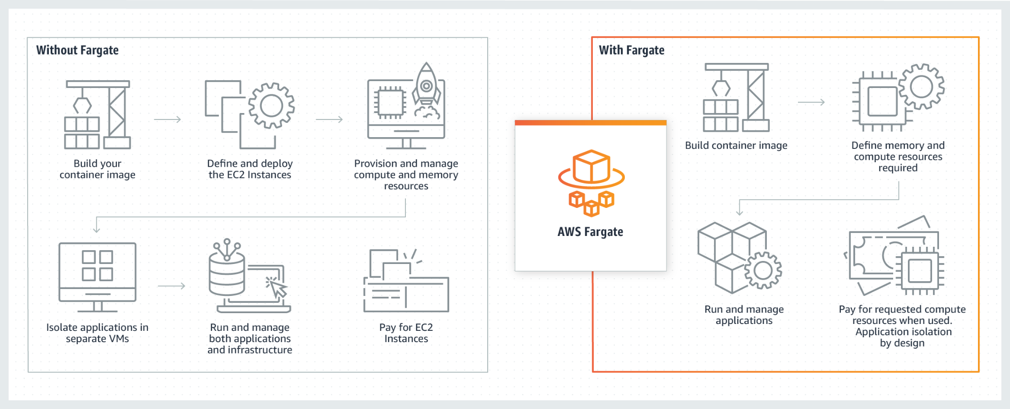
Fargate
https://aws.amazon.com/fargate/

Slide 32
Fargate vs Lambda
Lambda
1) Ideal for short-lived, event-driven functions. 15 minutes max to be exact.
2) Automatic scaling based on event triggers.
3) Fewer configuration options, simplifying deployment.

Slide 33
Fargate vs Lambda
Commonalities
1) Serverless - focus on code, not infrastructure
2) Per-second billing
3) Integrated with AWS IAM and CloudTrail
Cloudtrail: assists governance compliance

Slide 34
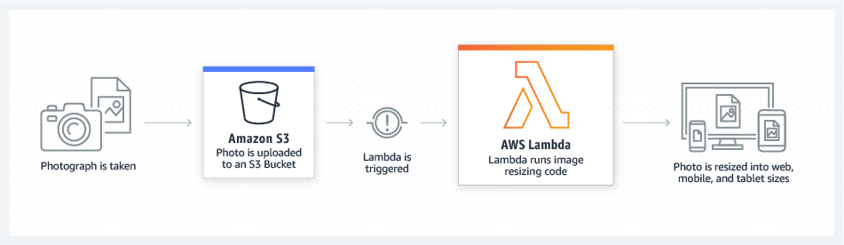
Lambda - File Processing
Use Amazon Simple Storage Service (Amazon S3) to trigger AWS Lambda data processing in real time after an upload, or connect to an existing Amazon EFS file system to enable massively parallel shared access for large-scale file processing.

Slide 35
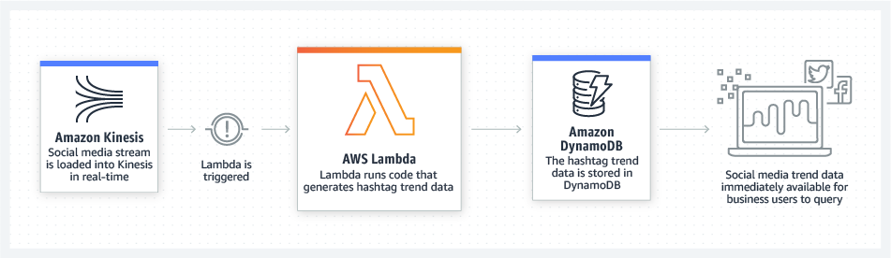
Lambda - Stream Processing
Diagram showing how Serverless stream processing works. Social media stream is loaded into Amazon Kinesis, then Lambda is triggered. Lambda runs code that generates hashtag trend data, and the data is stored in DynamoDB for easy querying.

Slide 36
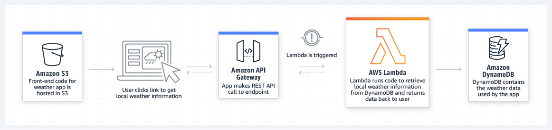
Lambda - Web Applications
Diagram showing how Amazon S3, API Gateway, AWS Lambda, and DynamoDB work together to retrieve weather data for a web or mobile application.

Slide 37
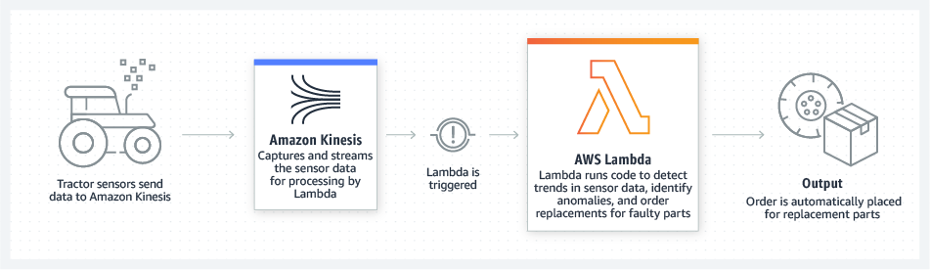
Lambda - IoT backends
Build serverless backends using AWS Lambda to handle web, mobile, Internet of Things (IoT), and third-party API requests.

Slide 38
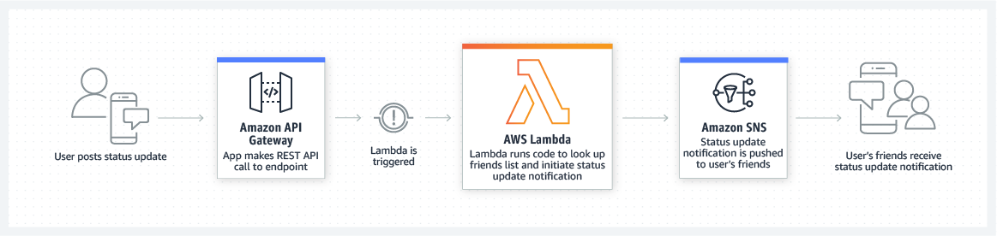
Lambda - Mobile backends
Diagram showing how Amazon API Gateway, AWS Lambda, and Amazon SNS work together to help users receive status updates notifications in a mobile application.

Slide 39
Amazon Elastic Load Balancer (ELB) Overview
Definition: Amazon ELB automatically distributes incoming application traffic across multiple targets, such as EC2 instances, containers, and IP addresses.
Purpose: ELB is designed to ensure your applications are highly available and offer consistent performance.
Types: Amazon ELB offers three types of load balancers – Application Load Balancer, Network Load Balancer, and Classic Load Balancer – each designed for specific use cases.

Slide 40
Types of Amazon ELB
Application Load Balancer (ALB): Best suited for load balancing of HTTP and HTTPS traffic. It operates at the request level and offers advanced routing, microservices, and container-based application features.
Network Load Balancer (NLB): Ideal for load balancing of TCP, UDP, and TLS traffic where extreme performance is required. It operates at the connection level.
Classic Load Balancer (CLB): Provides basic load balancing across multiple EC2 instances and operates at both the request level and connection level. CLB is intended for applications that were built within the EC2-Classic network.

Slide 41
Benefits of Amazon ELB
High Availability: ELB automatically scales its request handling capacity in response to incoming traffic.
Security: ELB works in concert with other AWS services like AWS Certificate Manager and AWS Identity and Access Management to provide robust security features.
Elasticity: Automatically scales with your incoming traffic, ensuring no over-provisioning or traffic congestion.
Health Checks: ELB continuously checks the health of your applications to ensure traffic only goes to healthy targets.

Slide 42
Use Cases of Amazon ELB
Microservices and container-based applications: Using Application Load Balancer, you can route traffic to multiple services or load balance across multiple ports on the same EC2 instance.
Build highly scalable and secure applications: ELB works seamlessly with Amazon EC2 Auto Scaling to ensure that your application can handle variations in traffic patterns.
Global Server Load Balancing: ELB, in combination with Amazon Route 53, allows you to achieve global server load balancing to route traffic to the closest healthy application instance. Note: Route 53 is Amazon’s DNS offering

Slide 43

Next topic
Storage
Source

Slide 44
Amazon S3 vs Azure Blob Storage
Both are object storage services suitable for unstructured data such as documents, social media data, images, and videos.
AWS S3 uses "buckets" while Azure Blob Storage uses "containers" for storing data.

Slide 45
Amazon Elastic Block Store (EBS) vs Azure Managed Disks
These are block-level storage services used with virtual machines.
Both services offer SSD and HDD-based volumes, encryption, and snapshot capabilities.
Amazon EBS offers a Provisioned IOPS service for high-performance SSD volumes, while Azure Managed Disks provides Premium SSDs for IO-intensive workloads.
Storage redundancy is identical to both AWS & Azure

Slide 46
Amazon Elastic Block Store (EBS)
Store the encryption keys in the EC2 instance
Results are fully encrypted both at rest and in motion.
No extra charge for encrypted disks

Slide 47
Amazon Elastic File System (EFS) vs Azure Files
Both are managed file storage services that can be accessed by multiple instances and devices simultaneously using standard file system semantics and access methods.
They are suitable for traditional enterprise applications that require shared file access.

Slide 48
Amazon S3 Glacier vs Azure Archive Storage
These are low-cost data archival storage services for long-term data retention.
They are ideal for data that is infrequently accessed and requires long retention periods.

Slide 49
AWS Storage Gateway vs Azure StorSimple
Both are hybrid storage services, allowing on-premises applications to seamlessly use cloud storage.
These services are useful for integrating local data center storage with cloud storage for backup, disaster recovery, and data tiering scenarios.

Slide 50
AWS Storage Gateway
File Gateway: Provides a file interface into S3 and combines a service and a virtual software appliance. It's effectively a way to use S3 as if it were a file server. This is file-based storage.
Volume Gateway: Provides block storage to your applications backed by S3. It presents the data as iSCSI devices. This is block-based storage.
Tape Gateway: Provides a virtual tape infrastructure that scales without the associated physical hardware. This is also block-based storage.

Slide 51
AWS Storage Gateway
Asynchronous backup is typically done at the block level. The reason for this is that block-level backup allows for a more granular control over data, which enables efficient incremental backups. Only the blocks that have changed since the last backup need to be copied, which can be more efficient in terms of storage space and transfer speed.

Slide 52
Amazon FSx vs Azure NetApp Files
These are managed file storage services based on popular third-party file systems.
Amazon FSx offers managed Lustre and Windows File Server, while Azure NetApp Files is a fully managed bare-metal NFS and SMB service powered by NetApp.

Slide 53
Lustre
An open-source, distributed file system designed for large-scale cluster computing. Known for its high performance, scalability, and flexibility.
Use Cases - Widely adopted in high-performance computing (HPC) environments. Used in industries requiring large data processing, such as meteorology, genomics, and 3D animation.

Slide 54

Take a break!
Go take 10 min. Fresh air, brain food, or a coffee.

Slide 55
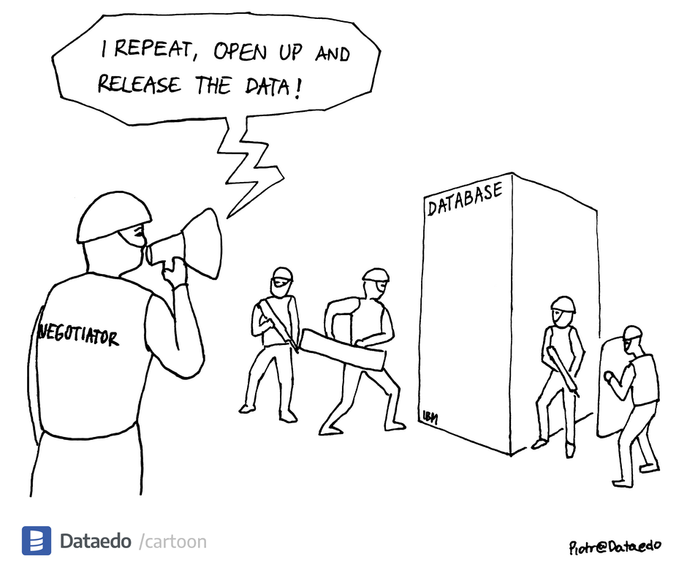
Next topic
Databases
Source

Slide 56
DIY Databases
Customization: DIY databases allow for extensive customization. You have the freedom to configure your database exactly as you want it.
Cost: Initial costs for DIY databases can be lower as you're just paying for the infrastructure. However, over time, costs can increase due to the need for maintenance, software updates, and potentially more hardware.

Slide 57
DIY Databases
Maintenance and Management: With a DIY approach, you're responsible for all aspects of database management. This includes setting up the database, backups, patching, scaling, and troubleshooting any issues that arise.
Scalability: While DIY databases can be scaled, this process often requires a significant amount of manual work and can lead to downtime.

Slide 58
DIY Databases
Security: You're also responsible for all aspects of database security. This includes setting up firewalls, encryption, and access controls.

Slide 59
Using a cloud providers database
1) Managed Service: Amazon's databases are fully managed, which means that Amazon takes care of all the heavy lifting. This includes maintenance, backups, updates, and scaling.
2) Scalability: Amazon's database services are designed to be highly scalable. They can automatically adjust to handle increased traffic and load, often without any downtime.
3) Security: Amazon's databases come with built-in security features, including encryption at rest and in transit, as well as advanced access controls.

Slide 60
Using a cloud providers database
4) Cost: While the cost for Amazon's databases can be higher initially, they often end up being more cost-effective in the long run. This is due to reduced maintenance costs and the ability to pay for only what you use.
5) Less Flexibility: One potential downside is that you have less flexibility compared to a DIY approach. While Amazon's databases offer a lot of features, they may not support every feature or configuration that you could implement with a DIY approach.

Slide 61
Amazon RDS (Relational Database Service)
Managed relational database service providing support for multiple database engines such as MySQL, PostgreSQL, MariaDB, Oracle, and SQL Server.
Automated backups, patch management, and failure detection and recovery.
Use case: Suitable for applications that require complex queries and transactions, such as CRM, ERP, and e-commerce applications.

Slide 62
Amazon RDS (Relational Database Service)
Relational Database Management System - RDBMS
Common RDBMS: MySQL, PostgreSQL, MariaDB, Oracle, and SQL Server.
Structured Data: RDBMS, is designed to handle structured data. It organizes data into tables, rows, and columns. Each table in the database corresponds to a different type of entity, and the rows within that table represent instances of that entity.
Schema: In RDBMS, you need to define the schema before you can add data to the database. The schema is a blueprint of how data is organized and accessed, including tables, fields, and relationships between tables.

Slide 63
Amazon RDS (Relational Database Service)
Relational Database Management System - RDBMS
Common RDBMS: MySQL, PostgreSQL, MariaDB, Oracle, and SQL Server.
ACID Properties: MySQL supports ACID (Atomicity, Consistency, Isolation, Durability) properties, which ensure reliable processing of database transactions.
SQL Queries: MySQL uses SQL (Structured Query Language) for querying and maintaining the database.

Slide 64
Amazon RDS vs Azure SQL Database
Both are managed relational database services offering support for multiple database engines.
Azure SQL Database is a fully managed relational database service based on the latest stable Enterprise Edition of SQL Server. Amazon RDS supports more database engines, including MySQL, PostgreSQL, MariaDB, Oracle, and SQL Server.

Slide 65
Amazon DynamoDB
Fully managed NoSQL database service offering seamless scalability.
Built-in security, in-memory caching, backup and restore, and in-place, real-time analytics.
Use case: Suitable for applications that need consistent, single-digit millisecond latency at any scale, such as mobile, web, gaming, ad tech, IoT, and many other applications.

Slide 66
Amazon DynamoDB
NoSQL Databases
Flexible Data: DynamoDB, as a NoSQL database, can handle structured and unstructured data, and there's no need to define a strict schema before inserting data. This makes DynamoDB more flexible than RDBMS for certain types of applications.
Scalability: DynamoDB is designed for high scalability, using distributed clusters of hardware to accommodate large amounts of data and high traffic levels.

Slide 67
Amazon DynamoDB
NoSQL Databases
Key-Value and Document Data Models: DynamoDB primarily supports the key-value and document data models. It's ideal for use cases where you need to store large amounts of data but need to access it quickly, such as in real-time bidding or gaming applications.
Eventual Consistency: By default, DynamoDB uses eventual consistency, which means there might be a slight delay (usually less than a second) in propagating data to all nodes. However, you can also opt for strong consistency if required.

Slide 68
Amazon DynamoDB vs Azure Cosmos DB
Both are managed NoSQL database services offering seamless scalability and global distribution.
Azure Cosmos DB offers multi-model support (key-value, graph, column-family, document), while DynamoDB primarily supports key-value and document data models.
Cosmos DB offers multiple consistency models, while DynamoDB offers eventual and strong consistency.

Slide 69
Amazon Aurora
Compatible with MySQL and PostgreSQL, Aurora is a relational database built for the cloud, with the speed and reliability of high-end commercial databases at 1/10th the cost.
It provides automatic scaling, replication across three Availability Zones, and backup to Amazon S3.
Use case: Suitable for enterprise applications that require complex queries, transactions, and interoperability with MySQL and PostgreSQL.

Slide 70
Amazon Aurora vs plain Amazon RDS
1) Aurora provides up to five times better performance than MySQL and three times the performance of PostgreSQL with compatibility, and it's designed to handle large scale, enterprise-level applications.
2) Aurora automatically divides your database volume into 10GB segments spread across many disks. Each chunk of your database is replicated six times across three AWS Availability Zones.

Slide 71
Amazon Aurora vs plain Amazon RDS
3) Aurora is designed to handle the loss of up to two copies of data without affecting database write availability and up to three copies without affecting read availability.
4) It's also highly scalable. You can add up to 15 low latency read replicas to further scale read capacity.

Slide 72
Why not run all loads on Aurora vs RDS?
The decision between using Aurora or RDS depends on your specific needs. Aurora may be overkill for small applications that don't require high throughput or advanced scalability features. RDS with a traditional database engine like MySQL or PostgreSQL could be more cost-effective for these applications.

Slide 73
Amazon Aurora vs Azure Database for MySQL and PostgreSQL
Performance: Amazon Aurora is often touted for its performance advantages. Aurora is designed to deliver up to five times the throughput of standard MySQL and three times that of standard PostgreSQL. This is due to various architecture optimizations such as distributed, fault-tolerant, self-healing storage system that auto-scales up to 64TB per database instance, and replicating data six ways across three AWS Availability Zones.

Slide 74
Amazon Aurora vs Azure Database for MySQL and PostgreSQL
Compatibility: Both Azure and AWS offer MySQL and PostgreSQL compatibility, but Aurora goes a step further by enhancing the base capabilities of MySQL and PostgreSQL while offering compatibility, resulting in better performance.
Scaling: Aurora provides up to 15 read replicas with sub-10ms replica lag, and it automatically grows storage as needed, up to 64TB per database instance. Azure Database services also offer read replicas and auto-grow feature, but the number of read replicas and storage limit might vary based on the pricing tier.

Slide 75
Amazon Aurora vs Azure Database for MySQL and PostgreSQL
Resilience: In Aurora, data is replicated six ways across three Availability Zones, offering higher durability. Azure Database services also provide data replication in multiple zones but the number of replications might vary.

Slide 76
Amazon Aurora vs Azure Database for MySQL and PostgreSQL
It's important to note that actual performance can depend on the specifics of your application and workload. While Aurora may generally offer higher performance, Azure Database for MySQL and PostgreSQL are still robust, scalable solutions that can handle demanding workloads. They also offer advantages in integration with other Azure services, particularly for organizations that are heavily invested in the Azure ecosystem.

Slide 77
Amazon Redshift
A fully managed, petabyte-scale data warehousing service.
It uses columnar storage, data compression, and zone maps to reduce the amount of I/O needed to perform queries.
Use case: Suitable for analyzing large datasets using business intelligence tools.

Slide 78
Amazon Redshift vs Azure Synapse Analytics (formerly SQL Data Warehouse)
Both are data warehousing services that allow analysis over large datasets.
Both support integration with various data visualization tools and offer columnar storage for improved query performance.

Slide 79
Data Warehousing Service
Centralized Storage: A data warehousing service stores large volumes of structured and semi-structured data from various sources, such as transactional databases, log files, and APIs, in a single, centralized repository optimized for analytics.
Highly Scalable & Fast Query Performance: Data warehousing services are designed to handle massive amounts of data and provide fast query performance for complex analytics tasks, enabling users to extract valuable insights and make data-driven decisions.
Integrated Data Processing & Analysis: Data warehousing services integrate with data processing and analytics tools, such as ETL pipelines, data visualization platforms, and machine learning services, providing a comprehensive solution for organizations to store, process, and analyze their data.
ETL pipelines: ETL stands for Extract, Transform, Load. It's a type of data integration process:

Slide 80
Amazon DocumentDB
A fully managed document database service that supports MongoDB workloads.
It's designed to give you the performance, scalability, and availability you need when operating mission-critical MongoDB workloads at scale.
Use case: Suitable for content management, catalogs, and user profiles.

Slide 81
Document database service
Flexible Data Model: Document databases store data in a flexible, semi-structured format like JSON, BSON, or XML, allowing for dynamic schemas and hierarchical data structures. This makes them well-suited for handling diverse, constantly evolving, or unstructured data without the need for rigid table schemas.
High Scalability: Document databases are designed for horizontal scaling, enabling them to handle large amounts of data and high read and write workloads. They often use techniques like sharding and partitioning to distribute data across multiple servers, ensuring high availability and fault tolerance.

Slide 82
Document database service
Ease of Development: With document databases, developers can store and query data in a format that closely resembles the data structures used in modern programming languages, making it easier to work with and integrate into applications. They also typically support powerful query languages and indexing features for efficient data retrieval and complex querying.

Slide 83
Amazon DocumentDB vs Azure Cosmos DB's MongoDB API
Amazon DocumentDB and Azure Cosmos DB's MongoDB API both provide managed database services compatible with MongoDB.
While both offer scalability and security, Azure Cosmos DB's MongoDB API offers global distribution and multi-model support (key-value, graph, column-family, document).
Key here is MongoDB is NoSQL and document oriented.

Slide 84
Amazon Neptune
A fully managed graph database service optimized for storing billions of relationships and querying the graph with milliseconds latency.
It supports popular graph models Property Graph and W3C's RDF, and their respective query languages Apache TinkerPop Gremlin and SPARQL.
Use case: Suitable for building and running applications that work with highly connected datasets, such as recommendation engines, fraud detection, and knowledge graphs.

Slide 85
Graph database service
Graph Structure: Graph databases use graph structures for semantic queries with nodes, edges, and properties to represent and store data. This unique structure allows them to model complex relationships easily and intuitively.
Performance: Because of their structure, graph databases can perform complex queries on connected data faster than relational databases. They are designed to extract complex relationships within data, which would require multiple JOIN operations in SQL databases.

Slide 86
Amazon Neptune vs Azure Cosmos DB's Gremlin API
Both are managed graph database services for building and running applications that work with highly connected datasets.
Neptune supports popular graph models Property Graph and W3C's RDF, and their respective query languages Apache TinkerPop Gremlin and SPARQL. Azure Cosmos DB's Gremlin API supports the Apache TinkerPop Gremlin graph query language.

Slide 87
Storage meets Databases
Data Lakes can be seen as a blend of both storage and database concepts, as they involve storing large quantities of data (like a storage system) and also organizing that data for analysis (like a database).

Slide 88
Storage Aspect
Data lakes store raw, unprocessed data in its native format, including structured, semi-structured, and unstructured data. This is more characteristic of a storage system. For instance, Amazon S3, a storage service, is commonly used as the foundational layer of a data lake in AWS.

Slide 89
Database Aspect
While data lakes do involve querying and analyzing data, this is typically done using separate analytics or processing services that interface with the data lake, not by the data lake itself. AWS Lake Formation makes it easy to set up, secure, and manage your data lake. It automates much of the heavy lifting of defining, securing, and auditing access to your data.

Slide 90
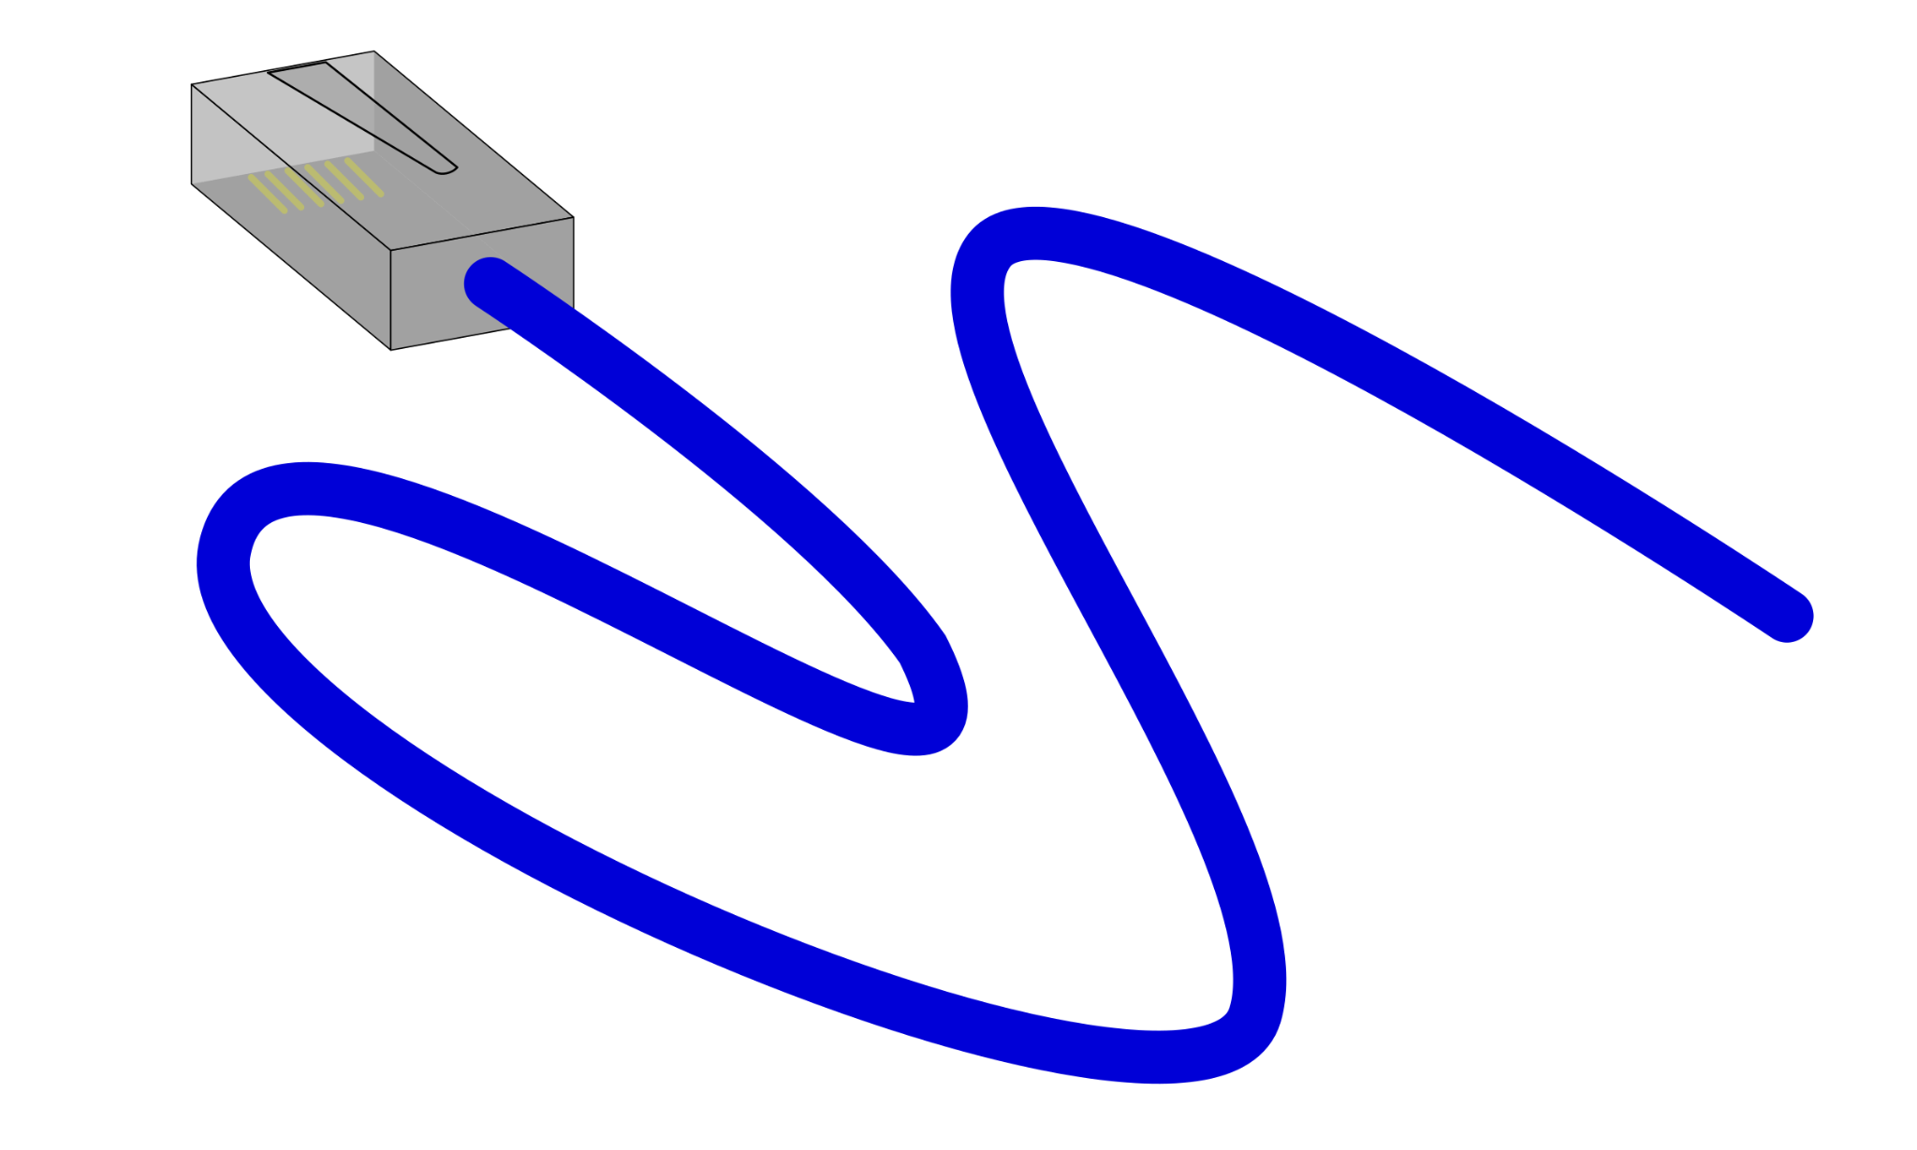
Next topic
Networking
OpenClipArt

Slide 91
AWS Network Services
We’ll introduce these, but there are a lot more.
Amazon VPC
Amazon Route 53
AWS Direct Connect
AWS VPN

Slide 92
VPC vs Azure Virtual Network
Both provide a logically isolated network in the cloud, with user-defined IP address range, subnets, and gateways.
VPC can be associated with multiple AWS Availability Zones for high availability.
Azure Virtual Network is region-specific but can be peered with networks in other regions.

Slide 93
Route 53 vs Azure DNS
Both are scalable cloud DNS services that connect user requests to infrastructure.
Route 53 additionally offers domain registration services.
Azure DNS requires a third-party domain registrar for domain registration.

Slide 94
Direct Connect vs ExpressRoute
Both provide a dedicated, private network connection from on-premises to the cloud.
Direct Connect and ExpressRoute increase bandwidth throughput and provide a more consistent network experience than internet-based connections.
Bandwidth options differ: Direct Connect (1 Gbps to 100 Gbps), ExpressRoute (50 Mbps to 100 Gbps).

Slide 95
AWS VPN vs Azure VPN Gateway
Both create secure and private sessions with IPSec and TLS tunnels.
AWS offers Site-to-Site VPN (on-premises to AWS) and Client VPN (individual users to AWS).
Azure offers Site-to-Site VPN (on-premises to Azure) and Point-to-Site VPN (individual users to Azure).
Note: Client VPN vs Point-to-Site is the same thing, just a different name.

Slide 96
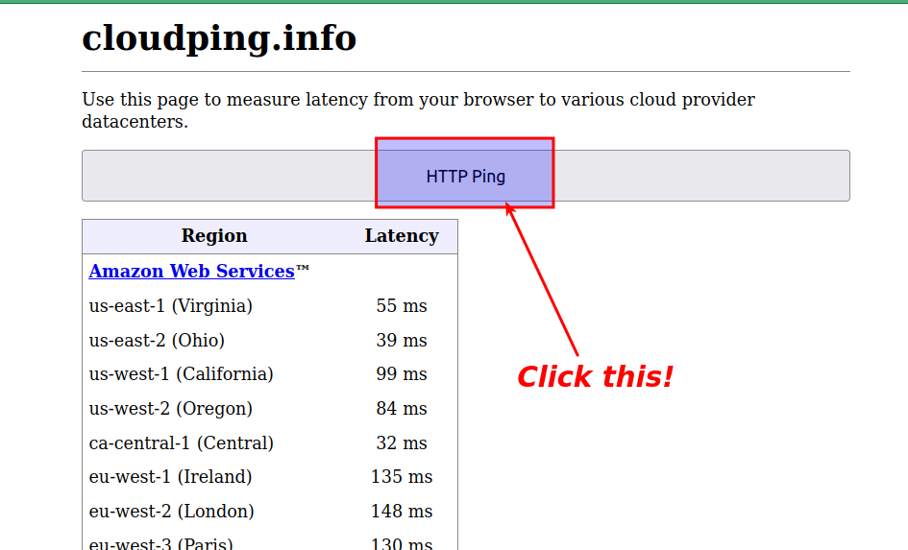
Cloudping.info

Slide 97
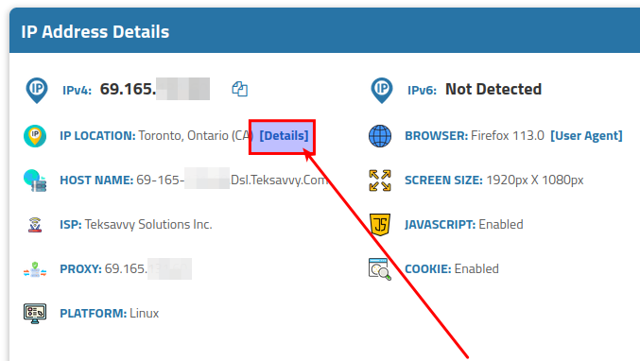
www.iplocation.net

Slide 98
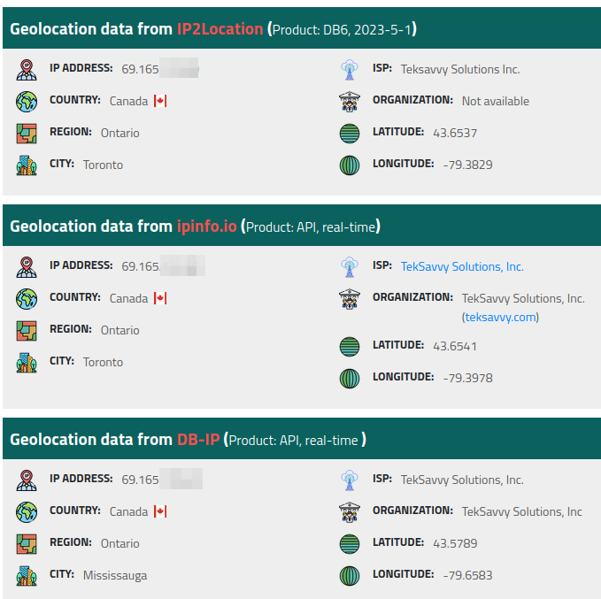
www.iplocation.net

Slide 99
Determine the nearest Point of Presence (PoP) for a user
Geolocation DNS: This method uses the user's IP address to estimate their geographic location. When the user's system makes a DNS request, the DNS resolver uses the IP address of the request to estimate the user's location and returns the IP address of the nearest PoP.
Anycast Routing: This is a networking technique where the same IP address is assigned to multiple servers in different locations. When a user makes a request, network protocols automatically route that request to the server with that IP address that's closest in terms of network hops. It is a popular method used for DNS servers and CDN PoPs.

Slide 100
Anycast
Routing Technique: Anycast is a network addressing and routing methodology in which incoming requests can be routed to a variety of different locations or "nodes."
Best Path Selection: Anycast relies on the routing protocol to select the best path to the nearest or best-performing node based on factors such as distance, latency, or cost.
Distributed Services: It's widely used in distributed services where multiple identical instances of a service can exist simultaneously. It helps in load balancing, redundancy, and reducing latency.

Slide 101
Anycast Routing example
Imagine that you have a radio station that is streaming audio content over the internet using Real-time Transport Protocol (RTP). You want to set up an Anycast network to ensure that listeners can connect to your stream from anywhere in the world with minimal latency. Here's a simplified version of how you could set this up:
1) Set Up Your Servers: First, you'd need to set up multiple servers in various geographical locations. Each of these servers would run your streaming application and have a copy of your radio content.

Slide 102
Anycast Routing example
2) Assign an Anycast IP: You would assign the same IP address to each of these servers. This IP address is known as an Anycast IP.
3) Configure BGP: You'd need to configure Border Gateway Protocol (BGP) on each server. BGP will advertise your Anycast IP to the rest of the internet, telling other networks how to route traffic to this IP. Each server will advertise the same path to the Anycast IP.

Slide 103
Anycast Routing example
4) ISP Routing: When a listener's device sends a request to your Anycast IP (to start streaming the radio station), their Internet Service Provider (ISP) would use BGP to determine the shortest path to one of your servers advertising that IP.
5) Stream Delivery: The chosen server would then start streaming the audio content to the listener's device using RTP.

Slide 104
Determine the nearest Point of Presence (PoP) for a user
Latency-based routing: This method involves continuously measuring the latency between its various PoPs and various major ISPs. When a DNS request comes in, the IP address of the PoP with the lowest latency to the user's ISP is returned.
Application-Level Check: Sometimes, an application might have its own mechanism to check latency to various PoPs, perhaps by having the client quickly ping several of them and then continue to use the one with the lowest latency.

Slide 105
AWS Edge Locations
This is Amazon’s Content Delivery Network (CDN) for AWS customers.
Global Network: AWS Edge Locations are part of a global network spread across cities and regions worldwide. This vast network allows content to be served closer to users, reducing latency and improving the user experience.
Dynamic and Static Content Delivery: AWS Edge Locations, through the use of Amazon CloudFront, can accelerate the delivery of both static and dynamic web content, including .html, .css, .php, and image files, as well as live streaming and on-demand video content.

Slide 106
AWS Edge Locations vs Azure Edge Zones
Azure Edge Zones are a relatively new offering by Microsoft that aims to bring Azure services and infrastructure closer to the edge of the network, i.e., closer to end-users for lower latency. There are three types of Azure Edge Zones:
Azure Edge Zones: These are owned and operated by Microsoft and offer Azure services at the edge of the carrier's network.
Azure Edge Zones with Carrier: These are small-footprint extensions of Azure located inside a carrier's data centers and directly connected to the carrier's network.
Azure Private Edge Zones: These are private customer-owned edge locations, typically within an enterprise premise or in a service provider-hosted environment.

Slide 107
AWS Edge Locations vs Azure Edge Zones
On the other hand, AWS Edge Locations are part of Amazon's Content Delivery Network (CDN) - CloudFront. They are sites deployed in major cities and highly populated areas worldwide to cache data and serve it to users with less latency.
Key differences are (on the next slide)

Slide 108
AWS Edge Locations vs Azure Edge Zones
1) Azure Edge Zones seem to offer a wider range of Azure services, not just those related to content delivery and DNS routing like AWS Edge Locations.
2) AWS Edge Locations primarily support services like CloudFront (CDN) and Route 53 (DNS), while Azure Edge Zones support a wider range of services, including VMs, Containers, and other Azure services.
3) Azure Edge Zones are meant to be a seamless extension of Azure, enabling developers to build and deploy applications as they would in Azure, but closer to their users. In contrast, AWS Edge Locations are not a direct extension of the AWS Cloud but are primarily for content delivery and DNS resolution.

Slide 109
Next week
AWS Security Fundamentals

Slide 110
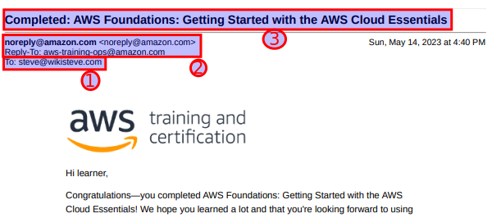
#1 your email address #2 from Amazon
#3 course name completed
DELETE EXAMPLE

